Slide 1
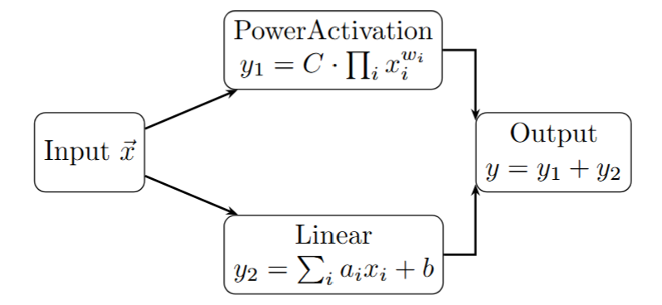
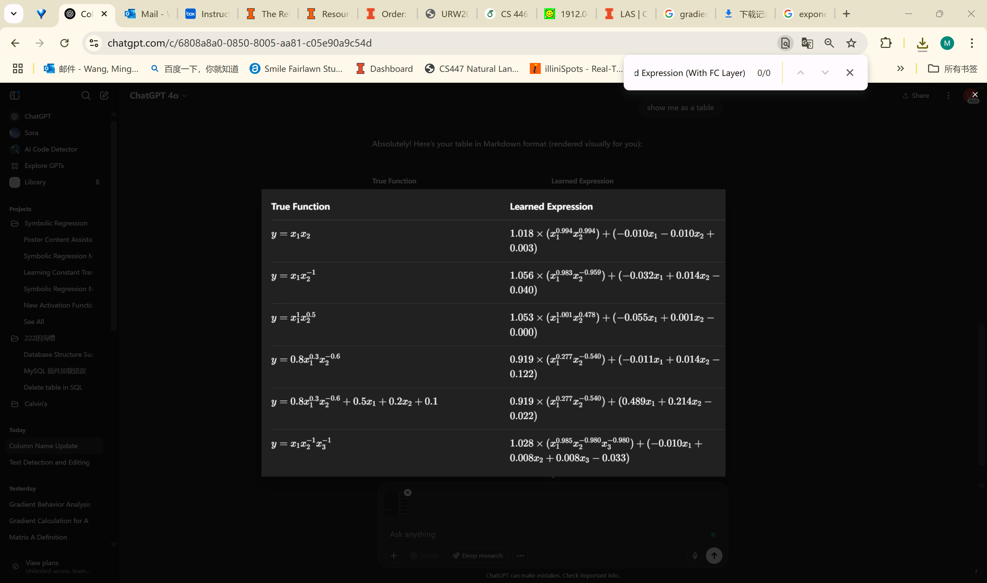

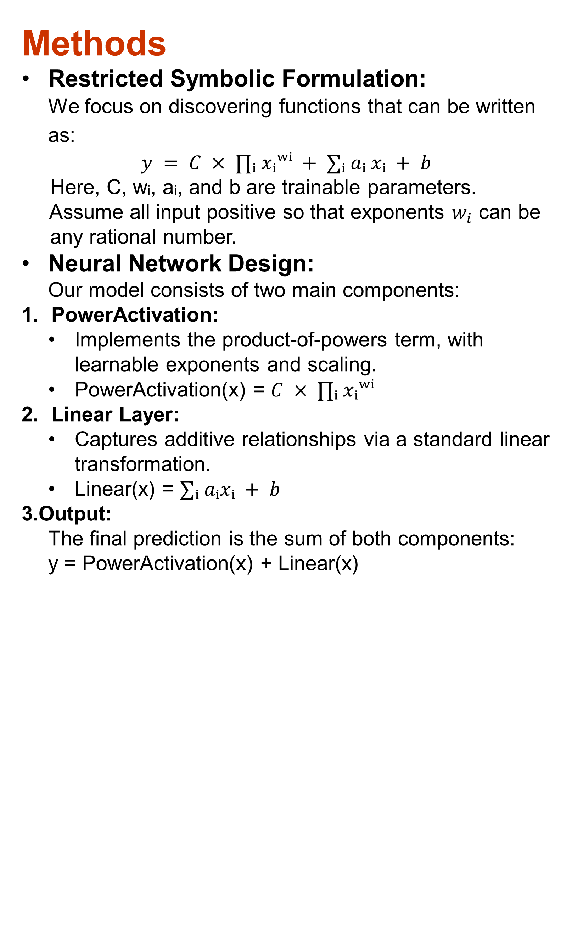
Bridging Deep Learning and Symbolic Regression: A Hybrid Approach for Interpretability and Expressiveness
Mingqian Wang
Department of Statistics, College of Liberal Arts & Sciences, University of Illinois at Urbana-Champaign
Introduction & Background
Challenge in Modern Machine Learning:
Deep learning achieves remarkable predictive accuracy, but most models are black boxes—they lack interpretability.
Classical symbolic regression (e.g., genetic programming) yields interpretable formulas but struggles with high-dimensional or noisy data.
Why Interpretability Matters:
Scientific and engineering applications often require explicit mathematical relationships to understand and trust model predictions.
Black-box models can’t reveal the underlying rules or mechanisms within data.
Bridging the Gap:
Develop a neural network architecture that combines the predictive power of deep learning with the explicit, structured outputs of symbolic regression.
By designing models that can directly extract mathematical relationships, we make data-driven discoveries transparent and actionable.
Observations & Motivations
EQL in Practice:
Extreme Sensitivity to Input Range
Example: y=1/x
When x is in (0,1) or contains negative values, EQL often encounters division by near-zero or negative numbers. This leads to exploding gradients and NaN values.
2. Reliance on Sufficient Data
If too few input points are provided, the network cannot reliably distinguish between different functions.
Extreme case: With just two points (0,0) and (1,1), both y=x and y= x^2 fit perfectly with zero loss, but the true underlying function remains ambiguous.
3. Poor Scalability to High Dimensions
As the number of input variables increases, EQL networks struggle to learn the correct expression.
The combinatorial complexity and risk of spurious fits grow rapidly.
4. Primitive Activation Set Overload
Including too many types of activation functions makes the network excessively wide and difficult to train.
Too many primitives cause poor convergence, increased overfitting.
5. Unsolvable Gradient Exploding
To address exploding gradients, I experimented with:
Logarithmic transformation (e.g., learning logz=−logx−logy instead of z=1/(xy))
Gradient clipping
However, these approaches did not fully resolve the instability or NaN values.
Motivation:
General symbolic regression models, such as EQL, often struggle to discover universal equations due to the issues mentioned above.
These models can suffer from difficulties in recovering the true underlying relationship from data without any prior assumption or knowledge.
By introducing reasonable assumptions about the target function’s structure and narrowing our focus to structured multiplicative and additive combinations, we make the project practical
Aim:
Specifically, we focus on functions that are represented as a product of input variables raised to trainable exponents, combined with a weighted sum of the inputs and a constant term.
By first addressing core technical challenges—such as instability, scalability, and sparsity—within this simpler framework, we can gain valuable insights and strategies that will guide the construction of more universal models in the future.
Methods
Restricted Symbolic Formulation:
We focus on discovering functions that can be written as:
$$y = C × ∏ᵢ xᵢʷⁱ + ∑ᵢ aᵢ xᵢ + b$$
Here, C, wᵢ, aᵢ, and b are trainable parameters.
Assume all input positive so that exponents $w_{i}$ can be
any rational number.
Neural Network Design: Our model consists of two main components:
PowerActivation:
Implements the product-of-powers term, with learnable exponents and scaling.
PowerActivation(x) = $C × ∏ᵢ xᵢʷⁱ$
Linear Layer:
Captures additive relationships via a standard linear transformation.
Linear(x) = $∑ᵢ aᵢxᵢ + b$
3.Output:
The final prediction is the sum of both components:
y = PowerActivation(x) + Linear(x)
Conclusion & Future Steps
This network achieves a reasonable fit to target symbolic functions.
Simply stacking more layers may not improve performance： If the correct function is discovered in the first layer, later layers should ideally perform a "constant transformation"—that is, transmit the result unchanged through the linear layer (i.e.weight = 1, bias = 0).In practice, standard neural network rarely learn this identity mapping reliably.
We plan to explore deeper architectures, while ensuring the network can still learn and preserve simple functions..
We aim to incorporate skip connections(e.g., ResNet-like design) so that partial solutions or "true function fragments" learned in earlier layers can be carried forward unchanged and combined with new features in later layers.
It’s essential to develop regularization techniques(e.g., minimizing the active neuron amount in each layer) that encourage sparsity, ensuring only the necessary network components are active. For example, if the true function is y=x^2 , ideally only the PowerActivation should be nonzero and the linear layer should always be zero.
Related Work & Technical Challenges
EQL (Equation Learner) Networks
Concept: EQL integrates symbolic regression with neural networks by replacing traditional activations with mathematical operations (e.g., +, ×, log, sin).
Technical Challenges:
Numerical Instability: Operations like division or log can cause numerical instability (e.g., division by zero, log of non-positive values, oscillation around 0).
Primitive Set Restriction: If the target equation uses operations not present in the network (e.g., division, non-integer powers), EQL cannot recover the true formula, no matter how well it trains.
Architecture Sensitivity: Success often depends on hand-tuning the network structure , initialization of weights, and regularization to prevent overfitting or trivial solutions.
Regularization and Sparsity:
EQL requires strong regularization to avoid overfitting or generating unnecessarily complex expressions. Achieving true sparsity is non-trivial—often, models activate too many nodes.
KAN (Kolmogorov-Arnold Networks)
Concept:
Inspired by the Kolmogorov-Arnold representation theorem, KAN replaces simple weights in an MLP with learnable univariate functions (splines).
Technical Challenge:
Complexity: Splines in KAN can become overparameterized, leading to potential overfitting and difficulty in extracting simple closed-form equations.
Figure 1. Network Architecture
References
Liu, Ziming, et al. "KAN: Kolmogorov-Arnold Networks." arXiv preprint arXiv:2404.19756 (2024). https://arxiv.org/abs/2404.19756
S. Kim et al., "Integration of Neural Network-Based Symbolic Regression in Deep Learning for Scientific Discovery," IEEE Transactions on Neural Networks and Learning Systems, 2021. doi:10.1109/TNNLS.2020.3017010
Results
Acknowledgments
I would like to thank Prof. Singh for his invaluable guidance, feedback, and support throughout this project.
Figure 2. Experiments Results

